Slide 1
PROMOTION REPORT
0<number>/11
Increase productivity in SMT process
CONTENTS
1
Current Job and new assignment in FY 2015
Page 02
2
Achievement in FY 2014
Page 03
3
Analysis problem and Action in 2015
Page 04-09
4
Action plan & Schedule Skill Up Myself and Subordinate
Page 10-11
Presented by : Duong Ngoc Thach
Join Date : 11/12/2007
Current Position : Supervisor
New Position : Ass. Manager
Section : SMT

Slide 2
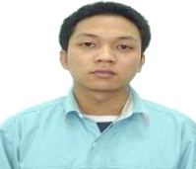
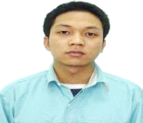
1. Current job and new assignment in FY 2015
0<number>/11
With ability leadership ➔ I will promote improve production method and human resource to increase productivity
MY POLICY: USING MANPOWER IS FEWEST TO GET HIGHEST MOUNTING POINT
BEFORE
AFTER
Hisatomi
GM
Hisatomi
GM
Strengthen
4M control
+ Method (Production, quality)
+ Manpower (Training center)
+ Material
(ware house )
Nguyen Van Kien
Manager
Nguyen Van Kien
Manager
Strengthen
Cooperation
Machine control
(ME team)
In-charger production
D.N.Thach
AM
D.N.Thach
Supervisor
Ware house
Quality
Control
Production
Production
Quality Control
Ware house
Training Center

Slide 3
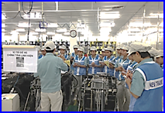
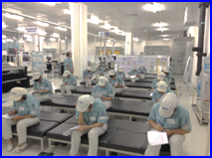
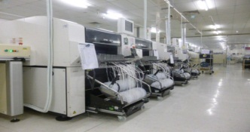
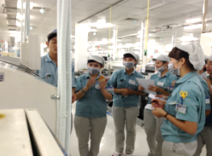
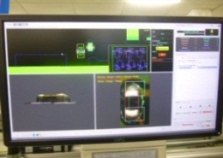
2. FY 2014 Achievement
➔ Quality and Efficiency all category achieved KPI target
0<number>/11
Achievement of myself in FY 2014
Strengthen control production
To achieve production result (PCB)
Make plan & hold training
Skill up for SMT member
Co-operation with ME apply NPM line, Visual check 3D
Category | Target | Act | Evaluate
PBX | 2,540,474 | 2,544,160 | 100%
DP | 3,393,121 | 3,395,911 | 100%
CPT | 298,733 | 298,926 | 100%
DECT | 8,730,161 | 8,731,096 | 100%
NPM Line
Increase mounting point
New
member
Maternity member
VC 3D
Reduce defect pass to next process
Hold
contest
Achievement in FY 2014
ITEM |  | OPBD | CPBD |  | TSBU | Average | Target | Evaluation
 |  | PBX | DP | DECT | CPT
Quality (PPM) | In process (PPM) | 9.28 | 9.21 | 6.42 | 7.40 | 8.10 | 8.45 | [O]
 | Next process (PPM) | 2.26 | 2.47 | 0.86 | 1.97 | 1.87 | 2.0 | [O]
Efficiency | Machine efficiency (%) | 79.0 | 82.6 | 86.0 | 78.9 | 81.6 | 81.3 | [O]
 | General efficiency (%) | 77.8 | 82.0 | 86.0 | 78.6 | 81.1 | 75.3 | [O]
Manpower |  | 188 | 163 | 46 | 12 | 409 | ❐ 41 person (8.5%) compare with FY 2013
5S,3T | Number 1 PSNV |  |  |  |  | No1 | No1 | [O]

Slide 4
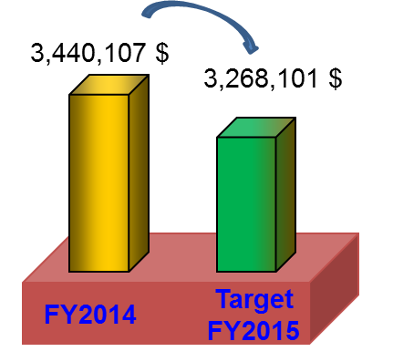
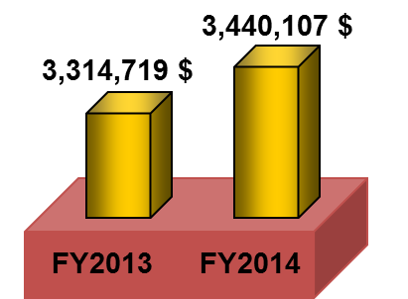
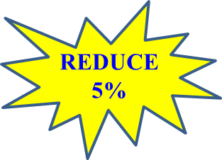

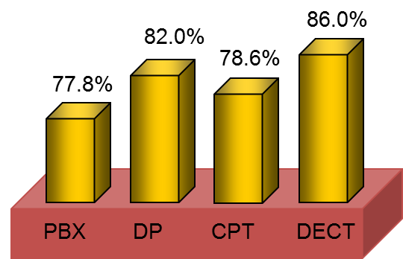
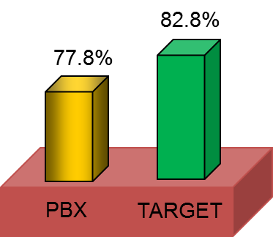
3. Analysis problem and Action in FY 2015
➔ To catch up factory policy Reduce expenses 5%
0<number>/11
TOTAL EXPENSES OF SMT IN FY 2014 (Update Feb-2015)
TARGET 1 :
Catch up factory policy
FY 2015 reduce 5% expenses
EFFICIENCY STATUS IN FY 2014
TARGET 2 :
Increase 5% Efficiency
of PBX
General efficiency
of PBX is lowest
In FY2015
PBX many model have small lot

Slide 5
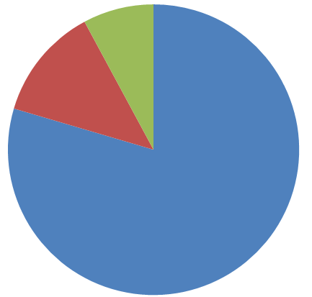
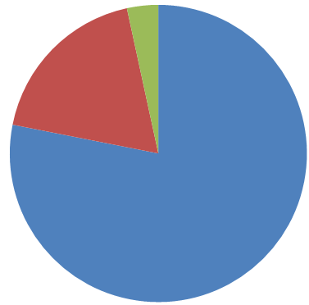
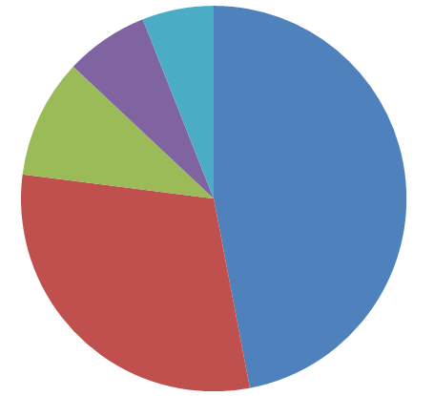
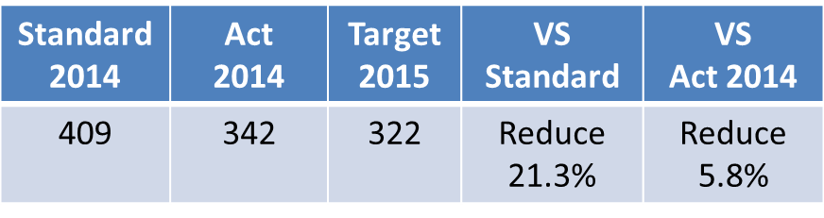
3. Analysis problem and Action in FY 2015
➔ To catch up factory policy Reduce expenses 5%
0<number>/11
TARGET 1 :
Catch up factory policy
FY 2015 reduce 5% expenses
TARGET 2 :
Increase 5% general efficiency of PBX
Total Expenses in FY 2014
Loss time break down
Loss time B break down
Inventory 11%
Sub-material 13%
Operating time
77.8%
Break time 30%
Labour cost 79%
Other
6%
Loss time
B 18.8%
Other 8%
Change model 47%
No plan
3.4%
Main issue 1
Reduce 21.3% manpower compare standard
(4.6% total expenses)
Main issue 2 :
Reduce 3.1% sub-material cost
(0.4% total expenses)
Main issue 3 :
Reduce 45% loss time no plan
(1.5% no plan)
Main issue 4 :
Reduce 42% change model time
(3.5% loss time B)

Slide 6
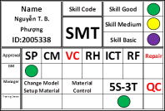

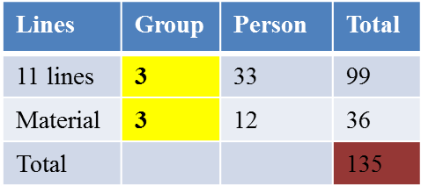
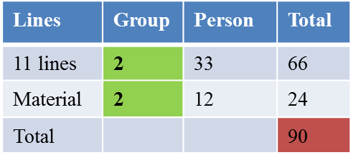
3. Analysis problem and Action in FY 2015
➔ To catch up factory policy : Reduce expenses 5%
0<number>/11
ISSUE 1 : REDUCE 21% MANPOWER VS STANDARD FY2014
Focus training by Training Center
to reduce 15.9% manpower (Reduce 65 person)
ACTIVITIES
BEFORE
AFTER
Action 1:
Training Multi-skill
Reduce manpower Target : Reduce 4.9% manpower
Plan: Feb → Nov /2015
Single skill
Multi - skill
2 lines = 6 (op)
2 lines = 5 (op)
SP
Mounting
VC
SP
Mounting
VC
Rotation
SP
Mounting
VC
❐ 20 Person
SP
Mounting
VC
Action 2:
Change method production of DP,CPT (From shift 4-2 to shift 5-2)
Target : Reduce 11.0% manpower
Plan : July/2015
Working 2 shift – 3 group
Working 2 shift – 2 group
45
person
To prepare
and strong management
3 item
1. Strong follow PSI (Apri-2015)
2. Operator skill (Feb-2015)
3. Forecast manpower
(Mar-2015)
To change working shift on schedule
(July-2015)

Slide 7
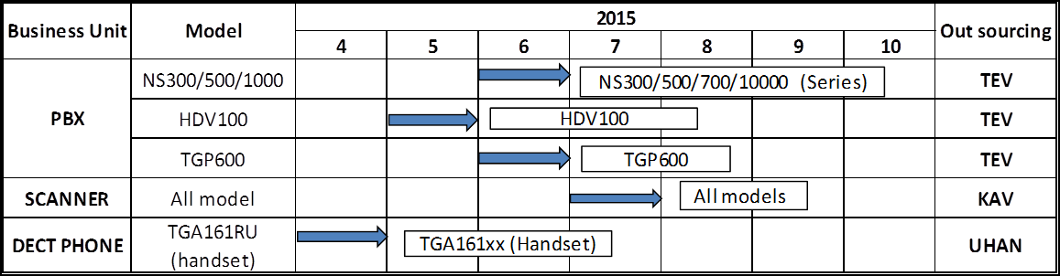
3. Analysis problem and Action in FY 2015
➔ To catch up factory policy Reduce expenses 5%
0<number>/11
ISSUE 1 : REDUCE 21% MANPOWER VS STANDARD FY2014
The manpower reduction 5.3% by outsourcing deployment (22 person)
● Follow up Schedule Deployment to outsourcing in FY 2015
( 10 person)
2 lines transfer
( 6 person)
● Out sourcing management system
( 6 person)
Apply to
Method: Document, OJT,
PSNV
Out sourcing
(TEV,UHAN,AIDEN, KAV)
Standard process
Standard 5S, 3T
Training good skills and multi-skill.
Analysis/Improvement
Follow up: audit 1 time/ month
(by SMT and OCS)
Inform problem
(Capacity, quality, material)
Build the SMT of PSNV become model factory

Slide 8
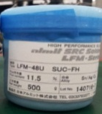
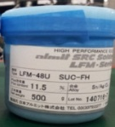
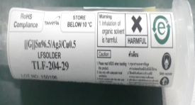
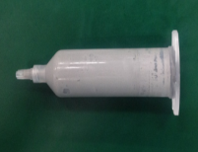
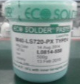
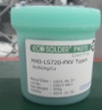
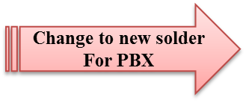
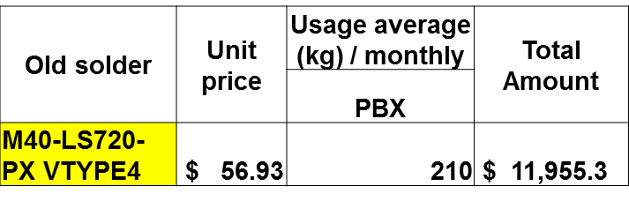
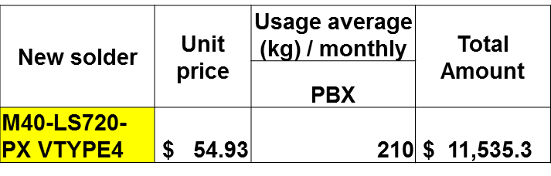
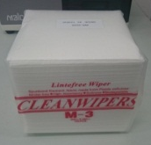
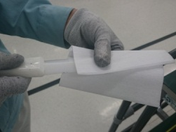

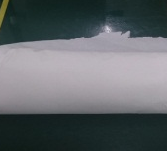
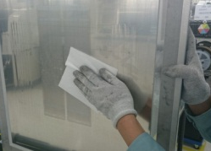

3. Analysis problem and Action in FY 2015
➔ To catch up factory policy Reduce expenses 5%
0<number>/11
ISSUE 2 : REDUCE 3.1% SUB-MATERIAL COST
➔ Cost down , reduce solder scrap, using paper recycle
ACTIVITIES
BEFORE
AFTER
Action 1:
Reduce solder scrap by change solder
Target: reduce 188$/month (0.5%)
Plan : May -2015
Tube
Tube
Using for
SP machine
BOX
special solder
(Using for Robot)
Transfer from box to tube
3 month/time scrap due over expire
Action 2:
Continue change new solder for PBX (cost down)
Target : Reduce 420$/month (1.06%)
Plan: June-2015
M40-LS720-PX TYPE4
(senju )
M40-LS720-PXV TYPE4
(senju )
Action 3:
Use SP paper roll recycle to clean stencil and spatula plastic
Target: Reduce 630$/month (1.6%)
Plan : Apr-2015
Square clean paper
Recycle SP clean paper roll
Paper inside SP (recycle)
180 bag/month
(630$/month)
Save
(630$/month)

Slide 9
3. Analysis problem and Action in FY 2015
➔ To catch up factory reduce expenses 5%
0<number>/11
ISSUE 3 & 4 : INCREASE 5% EFFICIENCY OF PBX
Schedule is optimal to increase efficiency
ACTIVITIES
BEFORE
AFTER
Main action 1:
SMT make plan for al category to reduce loss time no plan
Target : Reduce 1.5% loss time no plan
(3.4% → 1.9%)
Plan: May-2015
PBX, DP, DECT Separate management
PBX,DP,DECT General management
SMT make plan OPBD
Date | w1 | W2 | W3 | W4 | Result
PBX | Plan | Plan DP | Plan |  | OK
DP | Plan |  |  |  | OK
Date | w1 | W2 | W3 | W4 | Result
PBX | Plan | No plan | Plan |  | OK
Loss time
Make plan support DP to reduce Loss time no plan
PCS make plan CPBD
Date | w1 | W2 | W3 | W4 | Result
DP | Plan |  |  |  | Delay
Training more 2 member can use Joy schedule
Main action 2 :
Combine 2 line to long line to production small lot
Target : reduce 3.5% loss time B
(18.5% → 15%)
Plan : Jul-2015
SP
CM402
DT401
Reflow
SP
CM
402
CM
402
DT
401
DT
401
Reflow
SP
CM402
DT401
Reflow
Setup long line to production small lot to reduce time change material
3 time/line/day
Model small lot production (many group) on 2 short lines
loss time to change material
7 time/line/day

Slide 10
4. Action plan in FY 2015
➔ Month by month confirm effect and update result
<number>/11
ACTION PLAN (Improvement) | FY2014 |  | FY2015
 | 2 | 3 | 4 | 5 | 6 | 7 | 8 | 9 | 2nd half
1. Training skill up to reduce 1 person/ 2 line
2. Change shift working of 11 line DP,CPT (from shift 4-2 to shift 5-2)
3. Follow up schedule to transfer Outsourcing
4. Change solder type using for shield cover
5. Change new solder for PBX
6. Use SP paper roll recycle to clean stencil
7. Making SMT plan to SMT control (Schedule is optimal)
8. Combine 2 lines to 1 line (line 84 & 85)
2
2
2
2
2
2
2
2
4
4 line
4 line
3 line
Handset
Dect
HDV
TGP/NS
SCAN
Test(OK)
PSN approve
Apply
Test
Apply
Training
Apply
Re-setup

Slide 11
4. Action plan in FY 2015
➔ Month by month confirm effect and update result
<number>/11
ACTION PLAN (Skill up) | FY2014 |  | FY2015
 | 2 | 3 | 4 | 5 | 6 | 7 | 8 | 9 | 2ndhalf
A- For Myself
1.Study management skill from Managers (Method: OJT), Soft skill training by GA
2. Study good point from sections to apply for SMT. (Method : kaizen meetings)
3.Study to lever up skill English language. (Study method : GA of courses).
B- For Subordinate
Support and train for 2 officers (To promotion to Supervisor in FY2016)
2. Training 2 members using schedule software to make production plan
3. Make schedule to training for all Operator
Soft skill training by GA
Study management from SMT manager
Study management from DIP & FA manager
Every month
English training
Knowledge & Skill
Management
Problem solving
Make action plan and follow up
Training
Follow up
Make schedule
Follow up
TRY MY BEST

